Slide 1
Performance PowerShell

Slide 2

Scott Corio
Enterprise Cloud Architect, Microsoft MVP – Azure (Cloud Native/PowerShell)
scottcorio
DumpsterDave
https://blog.shitstormbrewing.beer

Slide 3
Housekeeping
If you can’t hear me or see my content, please say something
I will preserve some time at the end of the session for Q&A
Clarifying questions during the presentation are welcome
Please hold use-case specific questions to the end

Slide 4
Disclaimer
PowerShell performance is often relative and situational
What worked last time may not work this time
What worked on one machine may not work on the next
What worked when you wrote and tested it 100 times will fail as soon as you put it in production
There are always exceptions

Slide 5
How do we Increase Performance?
Buy a faster Computer!

Slide 6
Extended Q&A

Slide 7

Okay wise guy…
How do we actually increase
performance?

Slide 8
Performance Impacting Behaviors
Cmdlet A vs. Cmdlet B
Syntax
Function Usage
Pipeline vs no Pipeline
Object Types
Suppress Output
Threading
Filters

Slide 9
Cmdlet/Syntax Choice
How Cmdlet or Syntax use can impact performance

Slide 10
To Cmdlet or Not to Cmdlet
Sometimes, there are multiple Cmdlets that deliver the same “result”, but in a different fashion
Get-WmiObject
Get-CimInstance
Sometimes the way we use a Cmdlet can allow us to use more performant options
Set-Content
Out-File
Cmdlets are easier and have safeties over “code”, but performance may not be as good

Slide 11
Sin-Tax (not just for the red-light districts)
Pay attention to comparisons in if statements.
Conditions that are more likely to evaluate as false should be the first conditions to examine.
Conditions that are more expensive to evaluate should be the last conditions to examine all else equal
Not all Methods/Cmdlets are created equal, even though they may be functionally equivalent
Statements > Cmdlets
Don’t use aliases
This isn’t so much for performance issues. However, aliases can be over-written and cause your code to either cease functioning, or do something malacious.
Case Sensitivity Matters

Slide 12
Demo
Syntax and Cmdlets

Slide 13
A quick word about arrays
The only good array is not an array.
DO NOT USE $Array += <thing>
Use Lists
$List = [System.Collections.Generic.List[<type>]]::New()
If you need an array because of input requirements:
$List.ToArray()
Array performance is not linear.

Slide 14
Collection Performance Compared
Array
List

Slide 15
Overlaying the data
Overlayed
Raw Data (PowerShell 7.4.4)
Array Size | Time (ms) | ms per element | List Time (ms) | ms per element
100 | 1.32 | 0.0132 | 2.19 | 0.0219
250 | 1.67 | 0.00668 | 3.96 | 0.01584
500 | 8.69 | 0.01738 | 7.01 | 0.01402
1000 | 11.28 | 0.01128 | 13.99 | 0.01399
5000 | 364.15 | 0.07283 | 73.98 | 0.014796
10000 | 4045.66 | 0.404566 | 162.16 | 0.016216
25000 | 12417.27 | 0.4966908 | 359.55 | 0.014382
50000 | 55629.96 | 1.1125992 | 809.68 | 0.016194
100000 | 233530.1 | 2.3353008 | 1451.05 | 0.014511

Slide 16
Pipelines

Slide 17
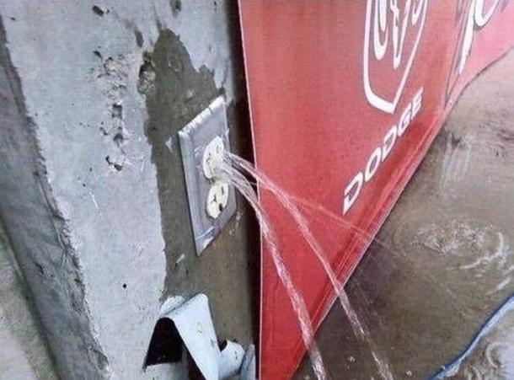
Know Your Pipes
Pipes can be a mixed bag when we talk about performance
Performance of pipes varies by cmdlet and type of data being passed
Pipes can have a lower memory footprint in some cases
Be careful with pipes if processing order matters or dealing with objects
Do I call a plumber? Or an Electrician?

Slide 18
Pipelines – A less fun version of Mario
Pipelines allow PowerShell to pass the output of one command directly to the input of the next
In some cases, using the pipeline is required (ex: Select-Object)
The pipeline does not respect order of structure, it respects order of arrival
The pipeline can not be interrupted
Even if we don’t need ALL of the output from the prior command, we still have to wait for it to complete before the pipeline completes

Slide 19
Demo
Pipelines

Slide 20
Get the Function Out of Here

Slide 21
Functions
Good for consistent, re-usable code
Not always so good for performance
Larger functions called less frequently are better than small functions called frequently
PowerShell is not compiled

Slide 22
Demo
Functioning

Slide 23
Measuring Performance

Slide 24
How do we Measure Performance?
Measure-Command
Works in *almost* all cases
Get-Date; Do Stuff; Get-Date
[System.Diagnostics.Stopwatch]
Trace-Command
Custom Function

Slide 25
Measure-Command/Trace-Command
Measure Command is like a wrapper for Invoke-Command coupled with a Stopwatch
Measure Command can measure a command, but the success (Write-Output) stream is not processed
Streams 2-6 are processed (Error, Warning, Verbose, Debug, Information)
Trace-Command can help us identify bottlenecks
Trace-Command –Name <TraceSource(s)> -ListenerOption <Prefix> -Expression <ScriptBlock> -PSHost

Slide 26
Demo
Tracing Commands and Measuring Performance

Slide 27
Multi-Threading

Slide 28
Jobs, workflows, and runspaces, oh my!
 | Jobs | Workflows¹ | Runspaces
Process Space | Background | Foreground | Either
Threading | Single Thread | Multi-Threaded | Multi-Thread Capable
Context | Separate Process | Thread/Process | Thread
Thread Safety | N/A | Built-In | Available
Pass Data | Copy | Copy | Reference²
PowerShell Version | 2.0³ | 3.0 | 2.0⁴
1: Windows PowerShell Only (Not supported in PoSh Core 6.0+)
2: Only for properly handled Key-Value Pairs
3: Scheduled jobs require version 3.0+, debugging requires version 5.0+
4: Debugging requires version 5.0+

Slide 29
PowerShell Parallel Processing Options
Jobs
Schedules a separate PowerShell process to run a script or script block
Jobs must be manually monitored and managed
Workflows
Deprecated – Don’t use them. For
Run as a new separate thread in the current process
limited data passing capabilities
Supports pause/resume
Must be manually monitored and managed
Runspaces
Every instance of PowerShell is a runspace
Can create worker pools to allow multiple threads to run simeoultaneously
Runspaces can perform parallel/batch processing of same tasks, or processing of separate distinct tasks
Pool counts can run anywhere from 1 to hundreds of threads
Workers are managed by the runspace pool

Slide 30
Creating a Job (faster than the government)
A Simple Job
$Job = Start-Job -Name “Name" -ArgumentList @($i) -ScriptBlock {
#DO STUFF
}
Wait-Job $Job
Receive-Job $Job

Slide 31
Taking the kids to the pool
Creating a Runspace Pool
$RunspacePool = [runspacefactory]::CreateRunspacePool($Min, $Max)
$RunspacePool.Open()
for ($i = 0; $i –lt $count; $i++) {
$PowerShell = [powershell]::Create()
$PowerShell.Runspace.Name = "Runspace_$($i)"
$PowerShell.RunspacePool = $RunspacePool
[void]$PowerShell.AddScript({ #DOSTUFF })
[void]$PowerShell.AddParameters(@{}) $PowerShell.BeginInvoke()
}

Slide 32
Demo
Runspaces

Slide 33
I fell asleep, what did we cover?
Stop using arrays
Use Runspaces for threading
Keep processing order and case sensitivity in mind
Put loops in functions, not functions in loops
Pipes are a mixed bag
Is the Cmdlet you’re using the best choice?
.NET calls are generally faster than their cmdlet counterparts, but less safe
Check your variable types. Avoid implicit type conversions

Slide 34
Real Q&A

Slide 35











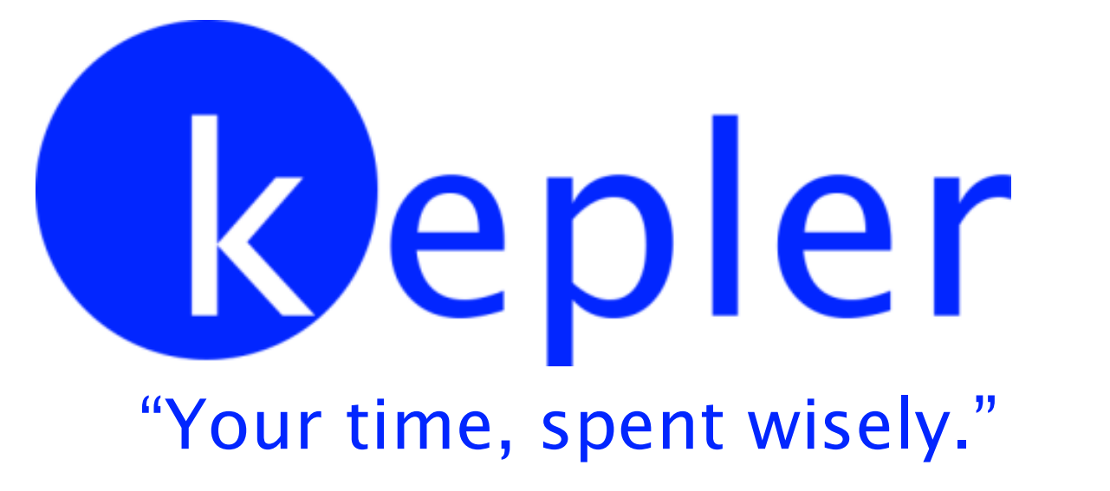

Thank you to our Sponsors!

